Slide 1
British airways analysis
SUBTITLE
Date

Slide 2
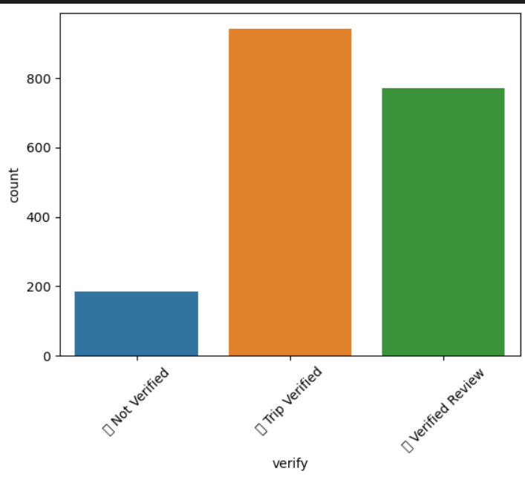

Graph
Interpretation:
Trip Verified has most frequently than not verified and verified review
That reviews has 3418 review
That reviews with category has 1894 review

